Slide 1
Lecture 26 Laplace Transform for Circuit Analysis
Hung-yi Lee

Slide 2
Reference
Chapter 10.3

Slide 3
What are we considering?
Complete Response
What really observed
Laplace
Transform
Final target
Zero State Response
Zero Input Response
Forced Response
Natural Response
Chapter 10
Chapter 6
Steady State Response
Transient Response

Slide 4
Laplace Transform for Circuit Analysis
小開有了不要繼承父業的念頭
第 N 層夢境
小開的父親說：
"I'm disappointed that you're trying so hard to be me."
清醒
進入夢境
現實
小開(競爭對手)解散公司
直接說服
小開

Slide 5
Laplace Transform for Circuit Analysis
Circuit in
s-domain
Branch variables
in s-domain
Node Analysis, Mesh Analysis, Thevenin, Norton Superposition ……
Inverse
Laplace
Transform
Laplace
Transform
Circuit in
time domain
Branch variables
in time domain
Differential Equation

Slide 6
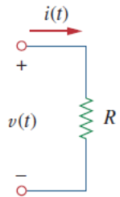
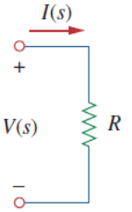
Resistor
Laplace
Transform

Slide 7
Voltage Source
Laplace
Transform

Slide 8
Current Source
Laplace
Transform

Slide 9
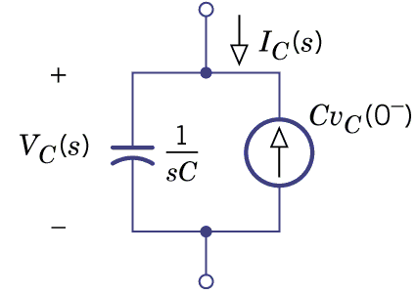
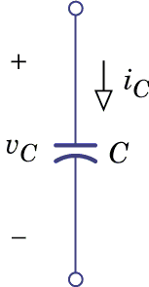
Capacitor
Laplace
Transform
Notes:
What is the meaning of 0-

Slide 10
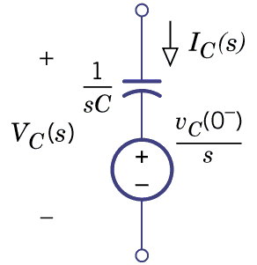
Capacitor
Laplace
Transform

Slide 11
Capacitor
Time Domain
s-domain
Source
Transformation

Slide 12
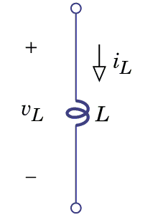
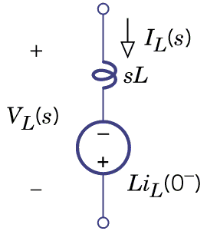
Inductor
Laplace
Transform

Slide 13
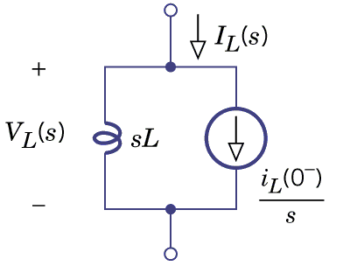
Inductor
Laplace
Transform

Slide 14
Inductor
Time Domain
s-domain
Source
Transformation

Slide 15
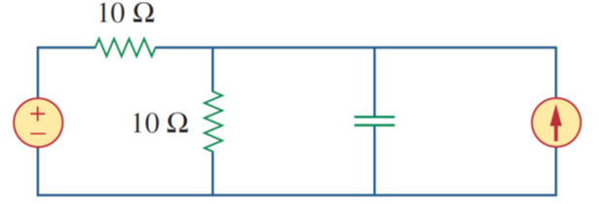
Example 1
Laplace
Transform

Slide 16
Example 1
Do inverse Laplace transform to find v_{o}(t)

Slide 17
Example 1

Slide 18
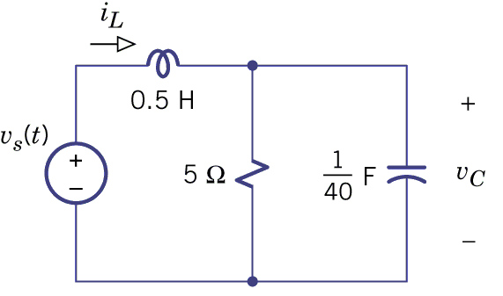
Example 2
A
B
A
B

Slide 19
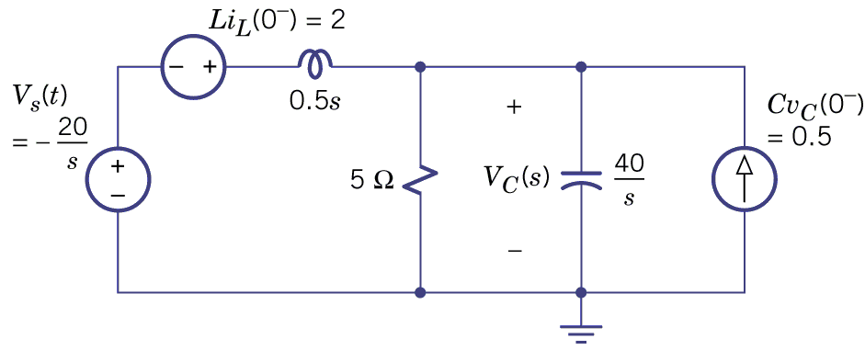
Example 2

Slide 20
Example 2
Do inverse Laplace transform to find v_{C}(t)

Slide 21
Example 2

Slide 22
Example 2

Slide 23
Laplace v.s. Phasor
(Chapter 13)
(Chapter 6, 10)

Slide 24
Laplace v.s. Phasor
Complete Response
Zero State Response
Zero Input Response
Forced Response
Natural Response
Phasor method (chapter 10)

Slide 25
Natural Response from Zero Input
If we set the initial conditions to be zero (zero-state)
Reduce to generalized impedance

Slide 26
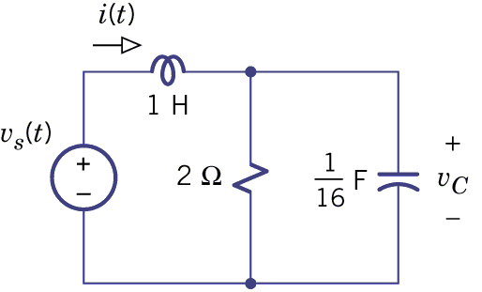
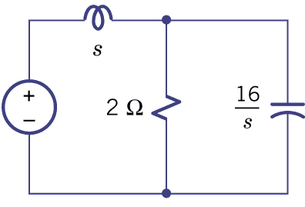
Natural Response from Zero State
Example 13.11: Phasor

Slide 27
Natural Response from Zero State
Example 13.11: Phasor

Slide 28
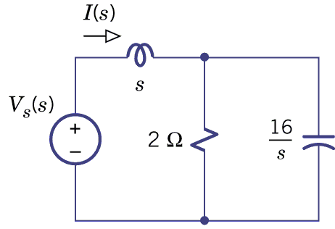
Natural Response from Zero State
Initial condition is all zero (zero state)
Example 13.11: Laplace transform
Laplace Transform

Slide 29
Natural Response from Zero State
Example 13.11: Laplace transform
Natural
Response

Slide 30
What actually happens in Chapter 10 and 11
Circuit, Filter
Forced response
If the initial condition is not zero
Natural response (for zero state)
Natural response (for zero input)
The complex frequency corresponding to poles
vanish eventually

Slide 31
Homework
13.51, 13.57, 13.58, 13.63, 13.65

Slide 32
http://sc.chinaz.com/tupian/141029398971.htm

Slide 33
Answer
13.51: y(t)=2-12te^{-3t}+e^{-3t}-3e^{-5t}
13.57: y(t)=-3 + 3.35e^{-t}cos(2t-26.6。)
13.58: i1(t)=8e^{-4t} – 2e^{-10t}
13.63: v1(t)=23.6e^{3t}cos(4t-32.0。)
13.65: VL(s)=20/(s²+14s+40), VL(0+)=0, VL’(0+)=20

